Slide 1
Mechatronics Simulation Lab

Slide 2
Summary
What are all the elements we are going to cover today.
Lab introduction
Tool used
Grades
Timelines
Software Introduction
Tutorial Problems
Q&A

Slide 3
Lab Introduction
Typical lab component introduction in WILP
Types of Lab – Virtual Lab and Remote Lab
Software Available
Remote Lab Equipment Available
Lab access
Slot booking
Login to server using Google Chrome / remote lab equipment using RDP
Virtual Lab -http://wilp-bits.platifi.com
Remote Lab - http://bitsmech.remotelabs.platifi.com
Lab quizzes
Lab exam
Grade : 22.5%
(10% (6% for Lab exam and 4% for lab quiz ) for Virtual Lab and 12.5% for Remote Lab)

Slide 4
Time Line
02/2/2020- Lab Session 1
09/2/2020- Lab Session 2
16/2/2020- Lab Session 3
23/2/2020- Lab Session 4
05/4/2020- Review Lab Session
Virtual Lab Starts : 04.02.2020 - 04.03.2020 Phase I duration 30 days Practice
Mid Sem Break
Virtual Lab reopens : 23.03.2020 - 04.04.2020 Phase II duration 16 days Practice
Proctored LAB Exams (Virtual Lab) Regular 06/4/2020- 12/4/2020 7 days
Makeup 13/4/2020- 19/4/2020 7 Days
Remote Lab : 09.02.2020 - 06.04.2020 Duration 55 days practice
There is no proctored exams for Remote Labs

Slide 5

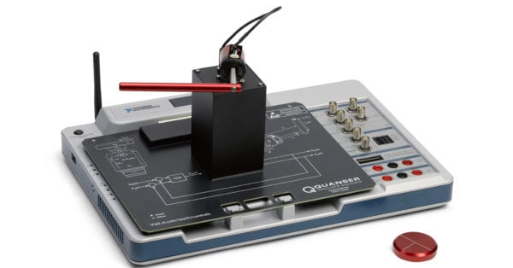
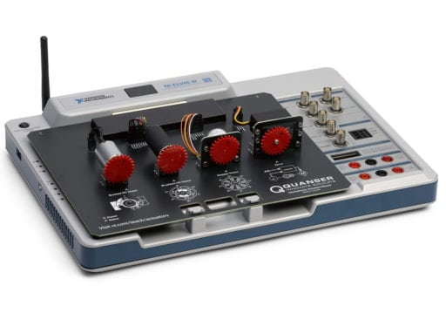
Tool Used
Typical Virtual Lab and Remote Lab tools
Virtual Lab –
Remote Lab – NI Elvis III with Mechatronics Actuators Board and Controls Board
Inverted Pendulum
Add-on ON button
Add-on ON button
Add-on Indicator
Add-on Indicator
Quanser Actuators add-on Board
NI Elvis III
Quanser Controls add-on Board
Disc

Slide 6
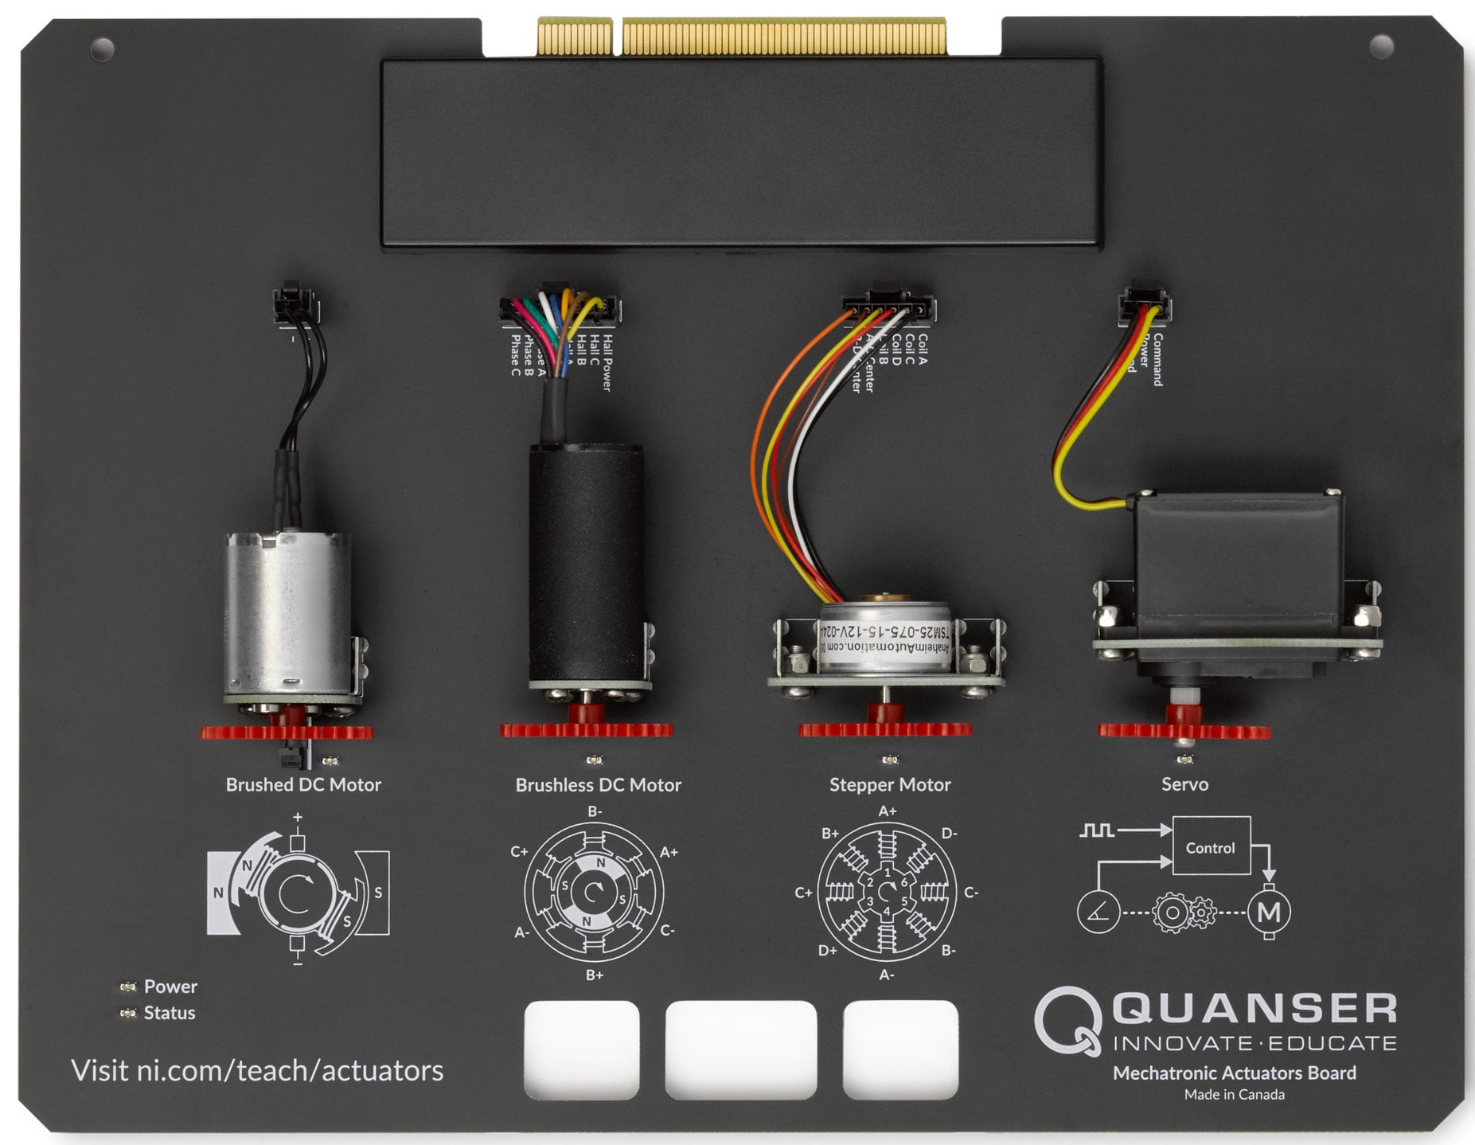
Quanser Actuators Board

Slide 7
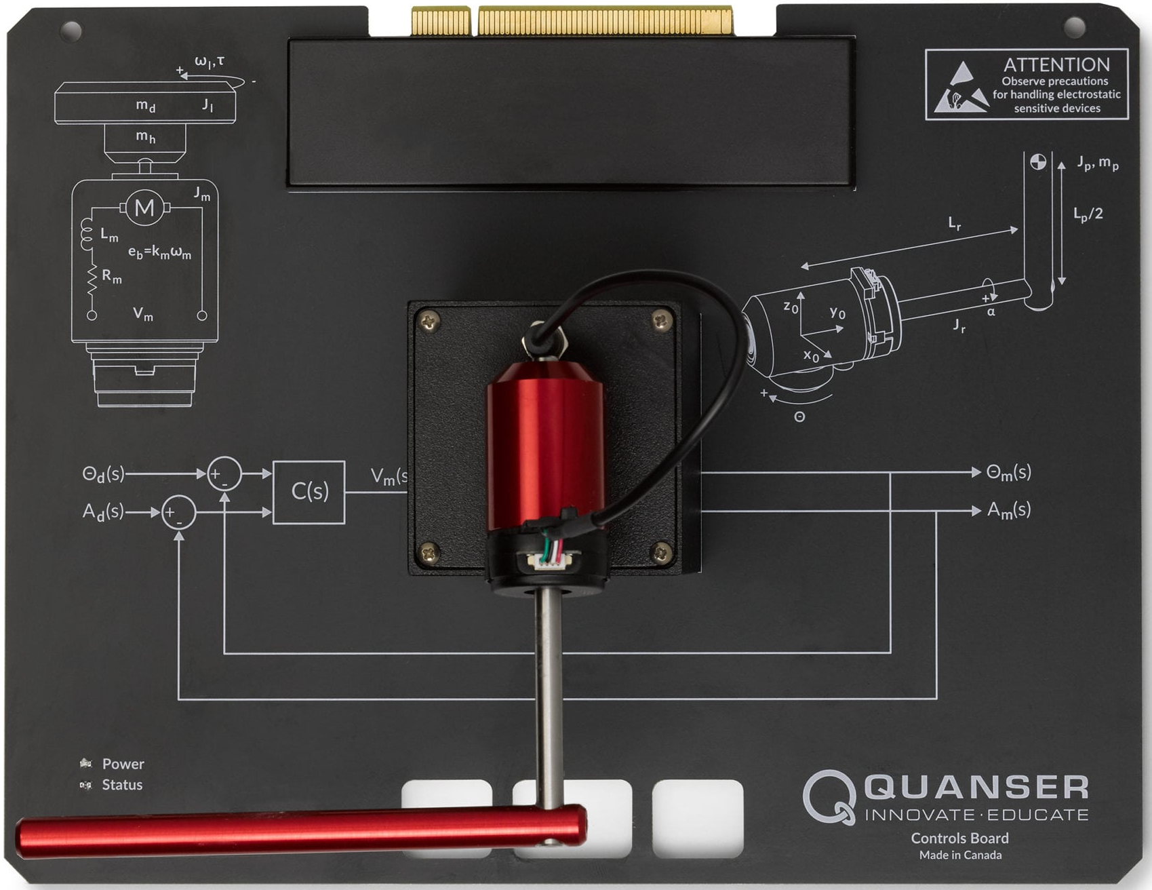
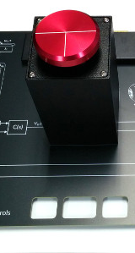
Quanser Controls Board
Disc
Encoder
Inverted Pendulum

Slide 8
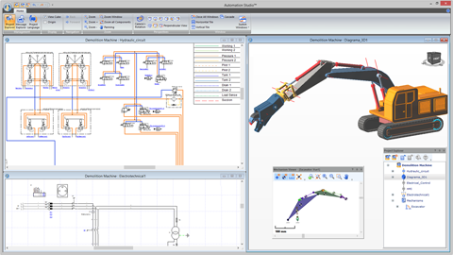
Automation Studio
Typical simulations
Circuit Design and Simulation Software
for Multiple Technologies:
Hydraulics
Electro-Hydraulics and proportional
Pneumatics
Electro-Pneumatics
Electrical Controls
Electro technical (AC/DC circuits & Motor Control)
PLC Ladder Logic, (Allen Bradley TM Siemens TM & IEC 1131)
Control Panels & 2D-3D HMI
Mechanical Links
Manufacturers' Catalogues
Sequential Function Chart (SFC/GRAFCET)
Digital Electronics
Electro technical One-line

Slide 9
Tutorial Problems
Practice problems for 4 hours of practice in Virtual Lab
Tutorial 1 Hydraulic Circuits
1A - Basic hydraulic circuit (one cylinder)
1B – Basic hydraulic circuit (two cylinders)
1C - Basic electro-hydraulic circuit
1D - Hydraulic circuit with proportional valves
Tutorial 2 Pneumatic Circuits
2A - Basic pneumatic circuit
2B - Basic electro-pneumatic circuit
2C – Pneumatic circuit with proportional valves
Tutorial 3 Sequencing
3A - Cylinder sequencing with electrical sensors (two cylinders A+B+B-A-)
Tutorial 4 PLC
4A - Basic PLC circuits
4B - Cylinder sequencing with PLC control (two cylinders A+B+A-B-)

Slide 10
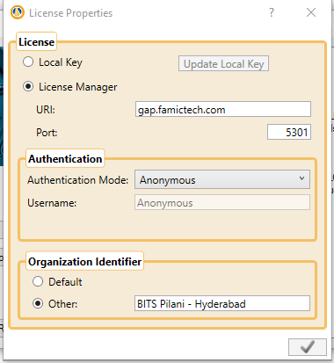
Important Steps in Virtual Lab
I need to use Automation Studio as a lab component do I have any steps to be followed?
Yes, we have some guidelines for you, as following:
Create working directory in the desktop with your BITSID
Configure license server (applicable only for Virtual Lab) and don’t worry it’s a one time process.
Open project and save project time to time
Take screen shots and save the same with you. (you can have a PPT created for this activity, keep adding screen shots in the same)
Close the tool once you are done
Close the RDP and
Finally don’t forget to give your ratings and comments for that session.
Use support whenever you face problem related to connection, password, software licensing issue
For technical issue use mail.
For instantaneous technical support alone please us watsapp.

Slide 11
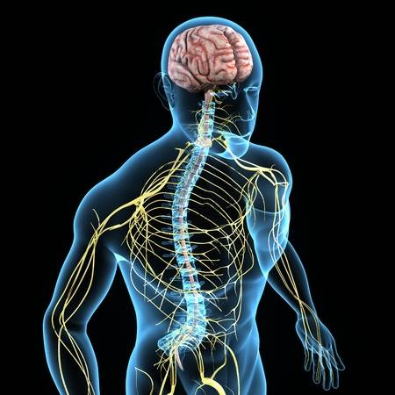
Mechatronics Literal Introduction
Which is the best mechatronics system in the world? Say some examples
Humans are the best example of a mechatronics system
(technically bio-mechatronics system)
Has several mechanical links actuated by the brains electronic signals
Several sensors are controlling the motion of the links using
either the program (repeated program or a habit of a human) or the sensor input (from skin, eyes, ears, nose and so on)
Humans will use vocal for conveying the message to other sensor
But what is mechatronics:
Mechatronics have following sources to actuate any element
Hydraulic
Pneumatic
Electronic
Included with sensor elements
within element/within system/ external system
Included with control elements
within element / within system / outside the system (local and global)
Mechatronic System
IoT
Humans
Image Courtesy: www.123rf.com

Slide 12
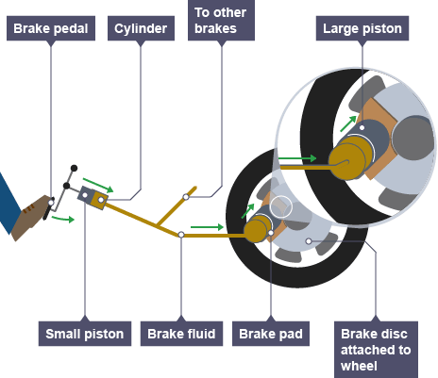
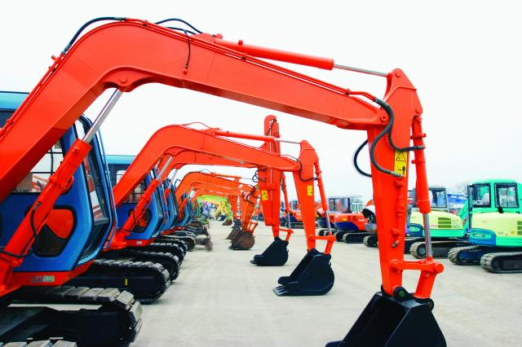

Cases
Image link
Image link
Image link
Earth movers
Slow down the flight and flap control
Hydraulics Brake

Slide 13
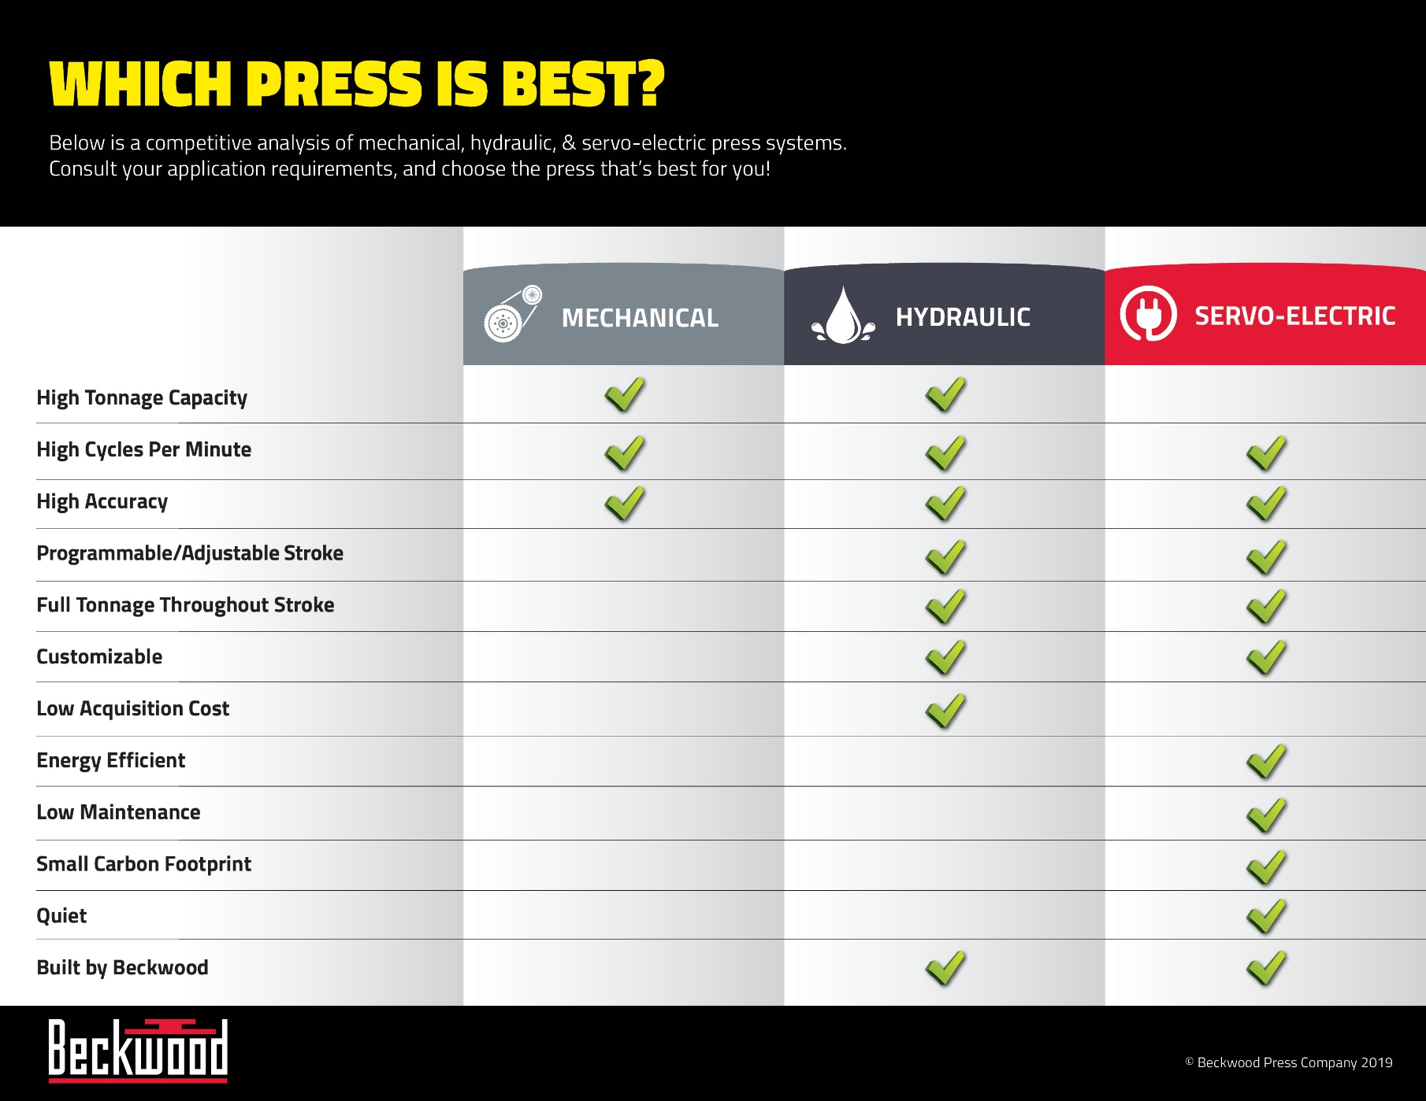
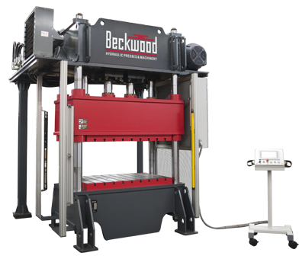
Cases
Hydraulics press for metal forming operations
Image link

Slide 14
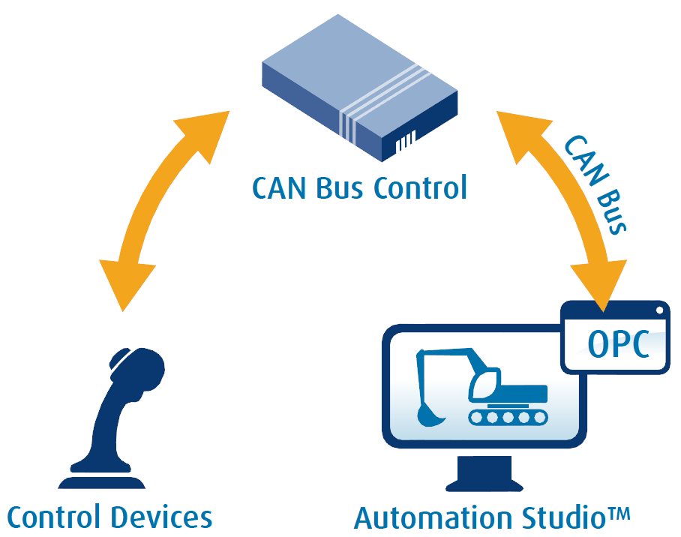
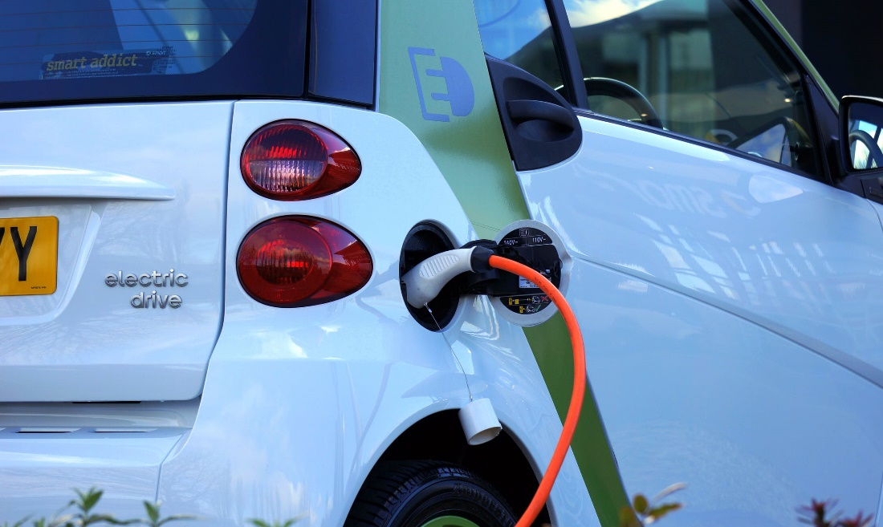
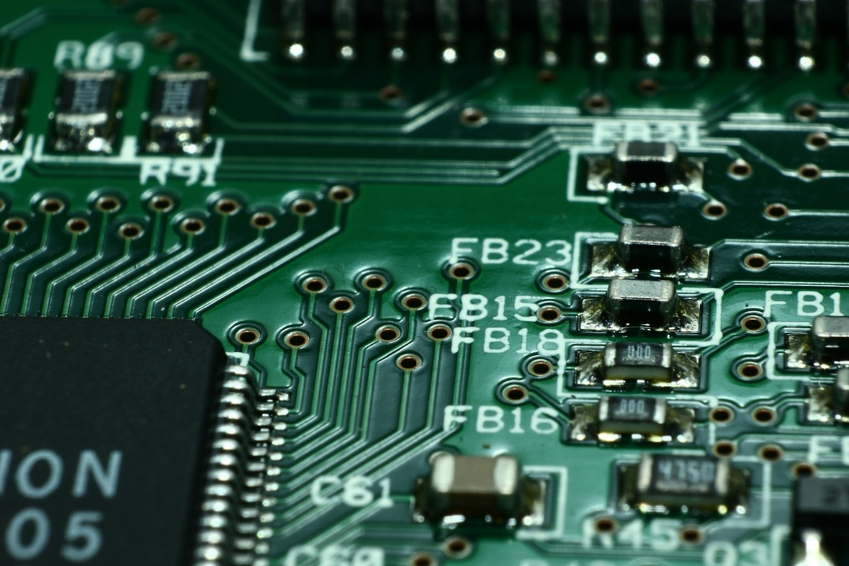
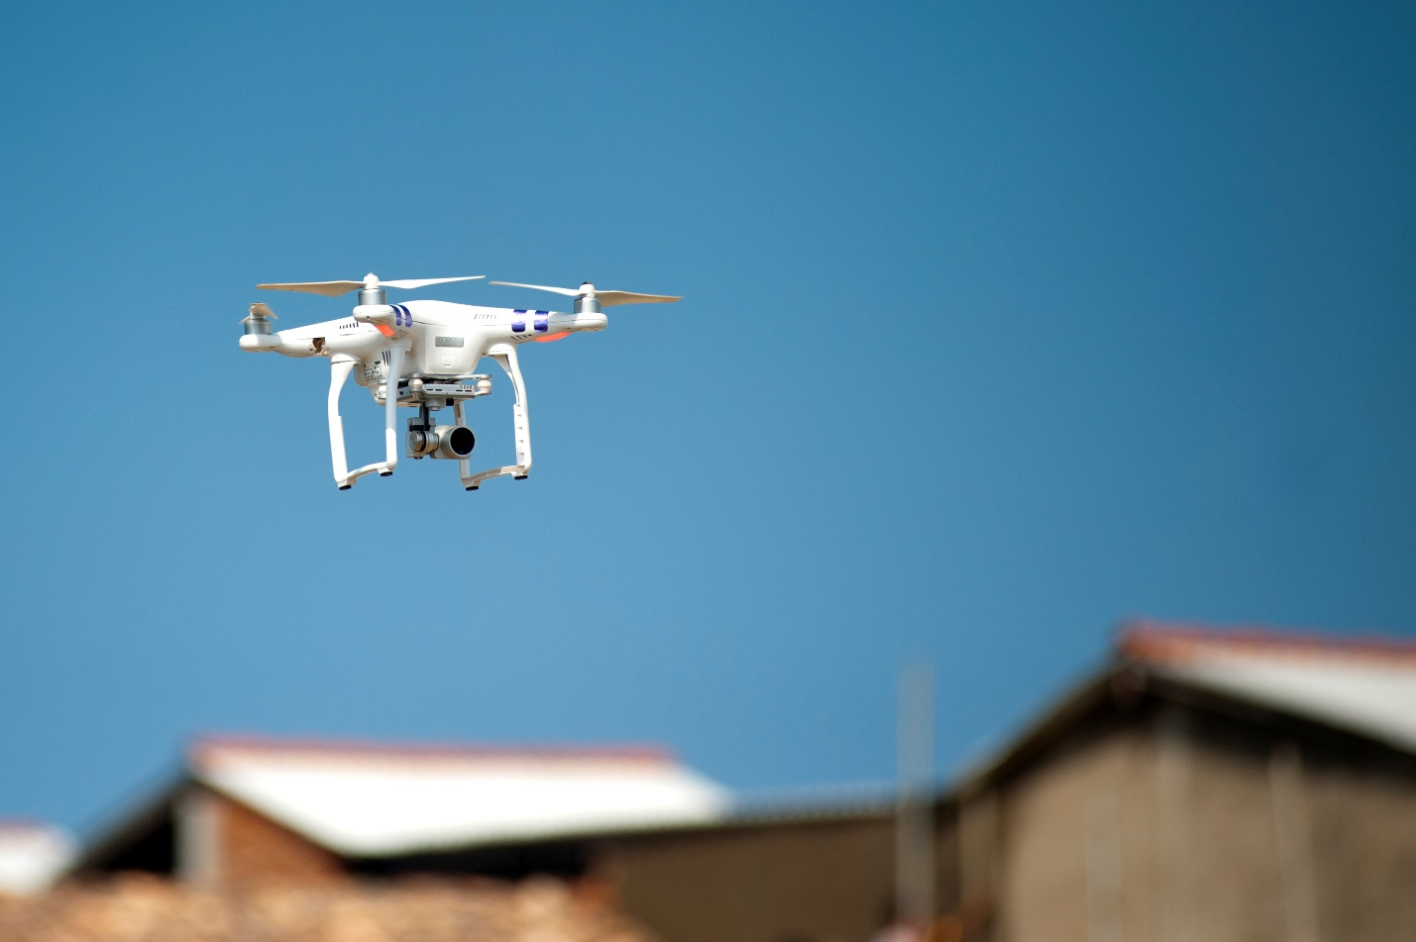
Cases
Vehicle cruise control is only one of the many applications of DC motor speed control
Courtesy : Famic Tech. (link)
Pick and place machines for PCB manufacturing are a great example of position control
DC motor modeling and control in drones
Courtesy : Quanser (link)

Slide 15
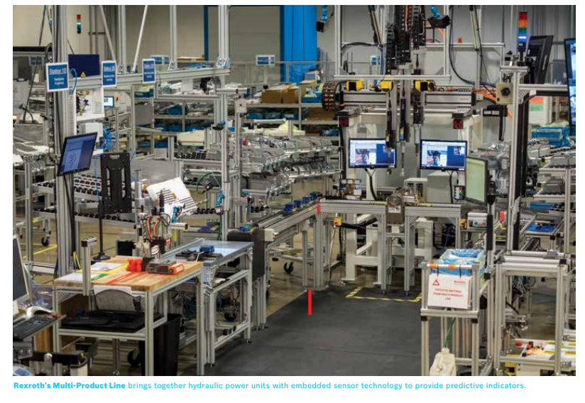
Cases
The Factory of the Future is Now – and it’s Everywhere
Robert Rexroth (A Bosch company’s popular case study)
Watch video for more details:
https://www.youtube.com/watch?v=M2q9ILQLbk8&t=4s
Tech Paper PDF link

Slide 16

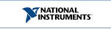
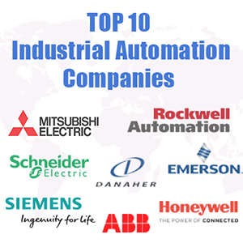





Sectors serving | Useful links | Industries
Automation is everywhere
Useful links
Agriculture and Forestry
Aviation
Community Infrastructure
Construction
Data Centers
Energy
Government & Military
Healthcare
Oil & Gas
Machine Building
Manufacturing & Industrial
Mining, Metals & Minerals
Pulp and Paper Manufacturing
Rail
Residential
Utility Industry
Vehicle / Transportation
https://www.boschrexroth.com/en/us/trends-and-topics/case-studies-tech-papers-and-viewpoints/case-studies/index
https://www.boschrexroth.com/en/us/trends-and-topics/case-studies-tech-papers-and-viewpoints/technical-papers/index
https://www.boschrexroth.com/en/us/trends-and-topics/case-studies-tech-papers-and-viewpoints/case-studies-archives/index
https://www.eaton.com/Eaton/OurCompany/SuccessStories/index.htm
https://www.rockwellautomation.com/global/news/case-studies/overview.page?
Popular Industries
Courtesy Eaton (link)
Popular industries published in controlglobal.com based on the business during the year 2017-18. Intention is to give insight about the implication of automation in industries, author is not responsible for any wrong information. link

Slide 17
Thank you

